Slide 1
Gov 1780: International Political Economy
Section 1
28 Jan 2021

Slide 2
Course requirements
Three take-home essays [3 x 20%]
90-minute midterm [15%]
90-minute final examination [15%]
Section attendance & participation [10%]

Slide 3
Getting oriented
Familiarize yourself with the Canvas site. Here you will find lecture outlines, handouts, readings that are not in the textbooks, study guides, section materials, and Zoom links.
Please join our Slack workspace (from Canvas) and use it as a place to ask questions and start discussions! This will also count towards your participation grade.

Slide 4
Scheduling
Lectures: Mon, Weds, 3-5pm EST
Section: Thurs 9am or 12pm EST
Office hours:
Prof. Frieden: Tuesdays 10am-11:30am and 2pm-3:30pm [sign-up required]
Sophie: Mondays 1-3pm [no sign-up]
Chelsea: Thursdays, 8am-9am, 10am-11am [no sign-up]
Note: all Zoom links should be available in Canvas (go to the “Zoom” tab). Please contact your TF is anything is missing!

Slide 5
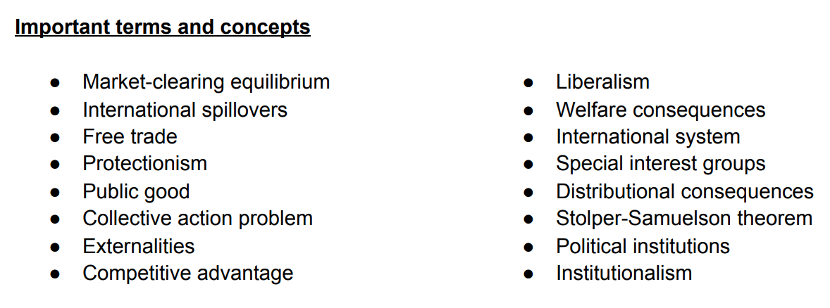
Readings
To help you stay on top of the readings, we have created study guides that outline the main concepts
You don’t need to complete all the readings for a topic before we start that topic in lecture, but it’s important to (i) come to class ready to participate; (ii) not fall behind!
A list of key concepts from Study Guide #1 - available on Canvas

Slide 6
We live in interesting times...
Teaching and learning online is hard!
We want to hear from you about what works – and what doesn’t – for online learning.

Slide 7
Analytical framework
In this class we are interested in positive rather than normative questions.
Is this question positive or normative? Can you convert it from one category to the other?
Should governments take action to combat rising inequality?

Slide 8
Analytical framework
In this class we are interested in positive rather than normative questions.
Is this question positive or normative? Can you convert it from one category to the other?
Should governments take action to combat rising inequality?
What are the main causes of rising inequality? How can governments reduce inequality?
Normative
Positive

Slide 9
Analytical framework: Unit of Analysis
In IPE, we analyze the behavior of a wide range of actors:
individuals (voters, workers, political leaders)
groups and organizations (firms, political parties, unions, industries)
nation states
supranational/international organizations (the EU, IMF, WTO, etc.)
When we talk about the unit of analysis, we are talking about whose behavior we want to explain.
Note: there is rarely one “correct” answer here… in some cases we might analyze the behavior of a nation state as if it were a unitary actor. In other cases we might want to dig into the domestic factions within a country.

Slide 10
Analytical framework: The Three i’s
Interests
What does each player want? Simplest case: material interests. Workers want higher wages, firms want greater profits. But there are non-material interests too! (environmental; altruistic; ideological; strategic)
Interactions
How do the players interact with each other? Think: coalition-building; tit-for-tat; reciprocity; coordination; etc.
Institutions
What are the “rules of the game”? Includes informal institutions (like social norms) as well as formal institutions (e.g. electoral systems; the EU, the WTO, etc.)

Slide 11
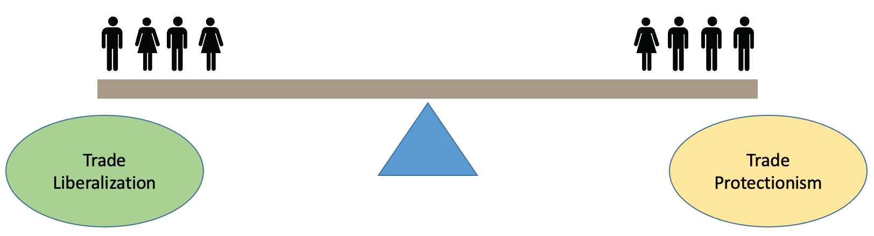
Consider two groups competing over trade policy.
The status quo may reflect a balance between these two interests
Why might some individuals favor more/less trade protection?

Slide 12
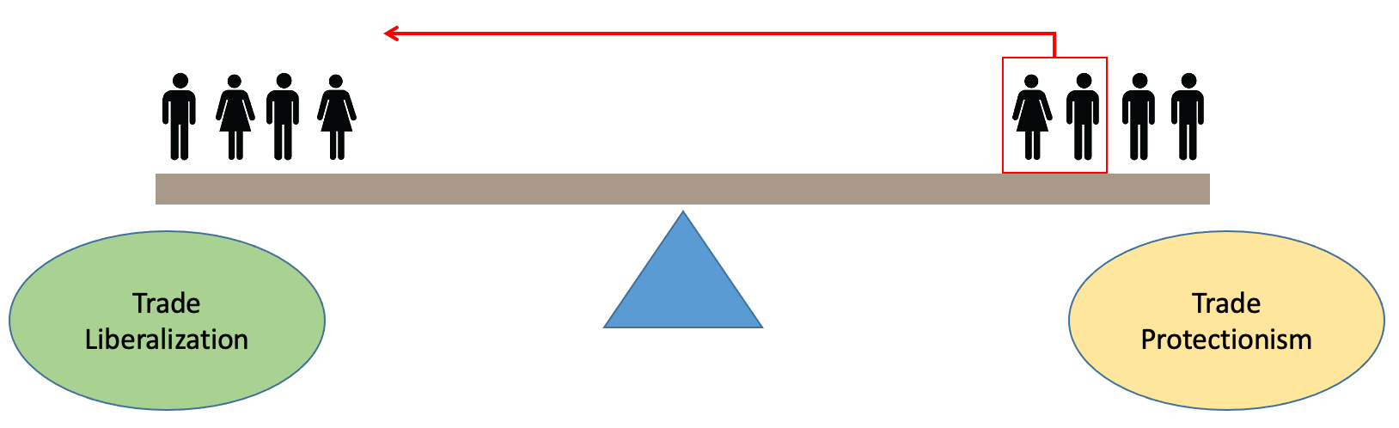
Now suppose that some workers become more pro-free trade… (perhaps because their sector becomes more internationally competitive).

Slide 13
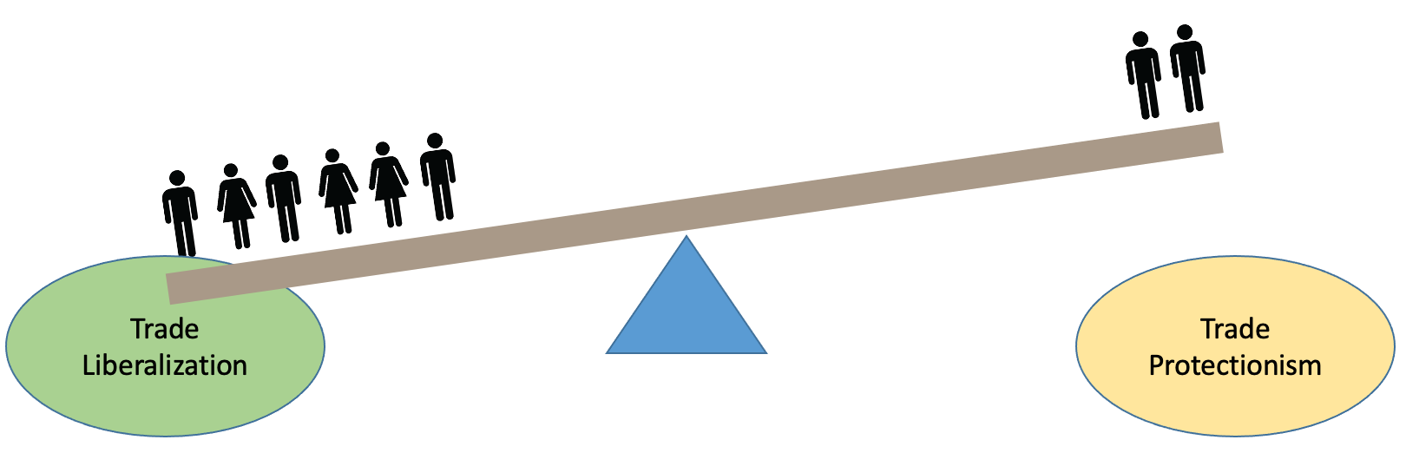
If we think purely in terms of interests, then we might expect this to cause a policy change in favor of trade liberalization.
Can you think of any reasons why this might not happen?

Slide 14
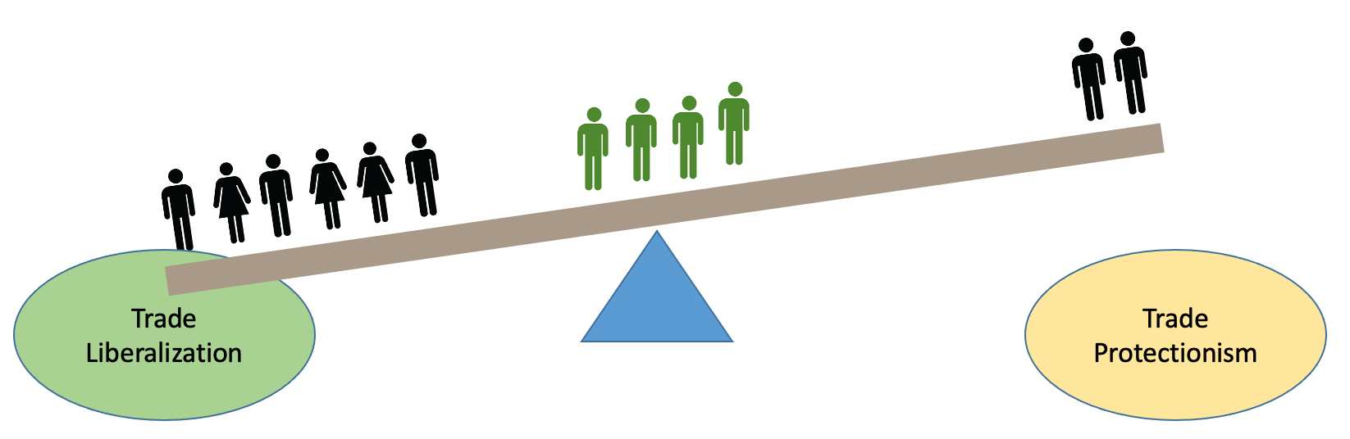
Interactions: Suppose there is a group of environmentalists that are neutral on trade policy and only care about environmental policy. The trade protectionists might be able to build a coalition with the environmentalists around a shared program.

Slide 15
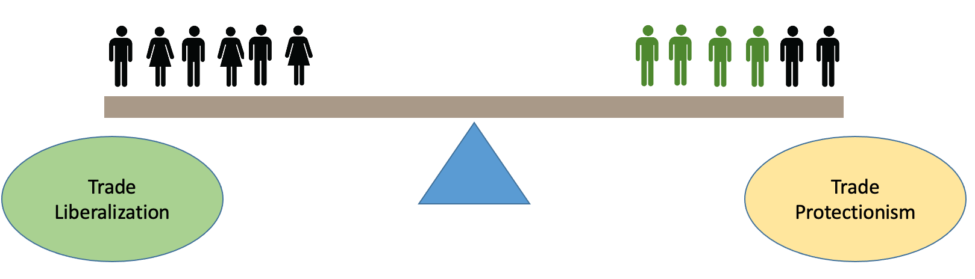
Interactions: Suppose there is a group of environmentalists that are neutral on trade policy and only care about environmental policy. The trade protectionists might be able to build a coalition with the environmentalists around a shared program.

Slide 16
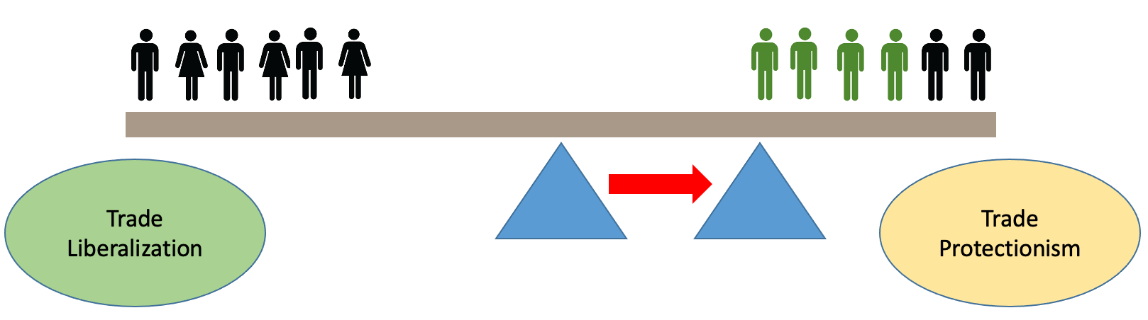
Institutions: Suppose that liberalizing trade policy only requires a simple majority vote, but making trade policy requires a supermajority.

Slide 17
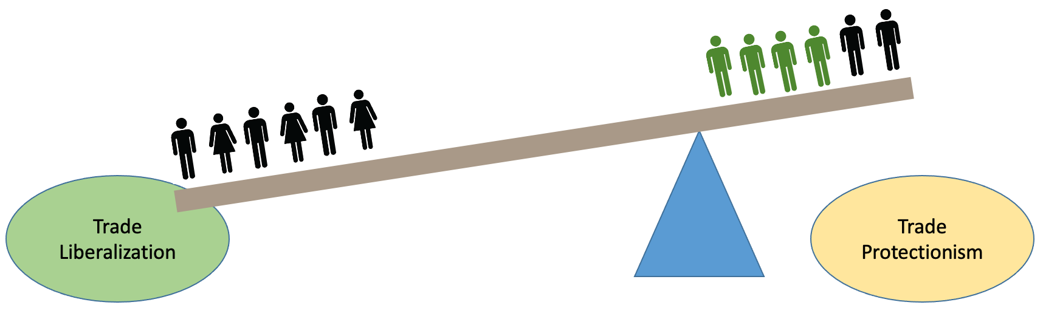
Institutions: Suppose that liberalizing trade policy only requires a simple majority vote, but making trade policy requires a supermajority.

Slide 18
Case study: UK vs EU vaccine dispute
Read this BBC News article and consider the following questions.
Who are the main actors in this dispute, and what are their interests?
How has Brexit shaped the way that the UK and the EU interact in this dispute?
How would this story have played out if the UK were still part of the institution of the EU?

